Slide 1
Street Law
Election Interest Meeting
Monday, March 19, 2018

Slide 2

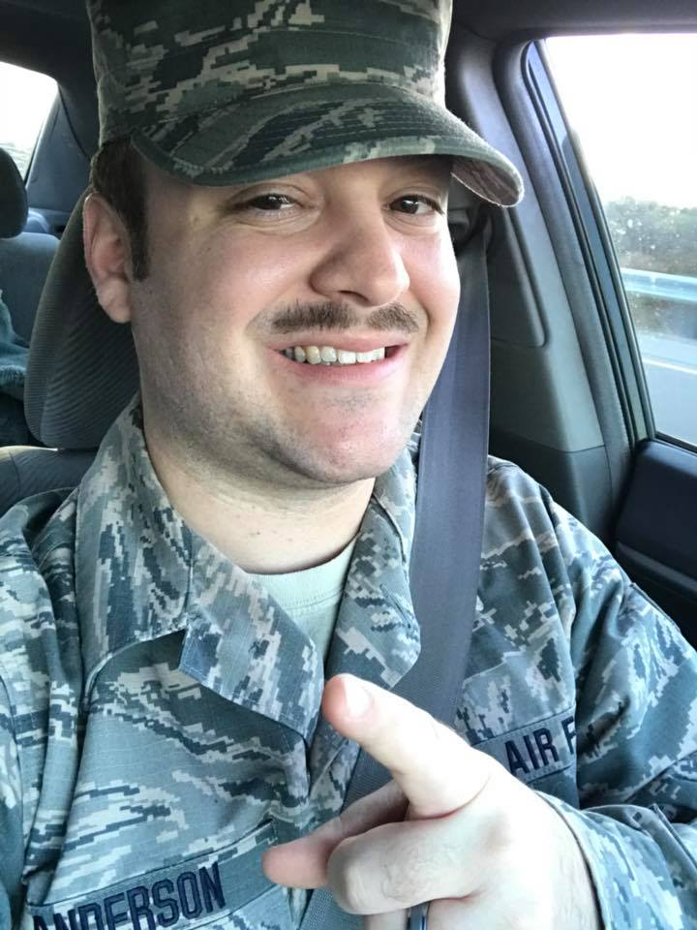
President
Alex Anderson

Slide 3
President
Chair meetings ensuring that they are run efficiently and effectively
Regularly focus StreetLaw’s attention on matters of governance that relate to its own structure, role and relationship
Work with the committee to ensure:
  The necessary skills are represented on the committee and that a succession plan is in place to help find new executive board members when required
  Goals and relevant strategic and business plans are developed in order to achieve the goals of the committee.
Serve as a spokesperson when required
Communicate regularly and systematically with the representatives of both StreetLaw and participating schools
Assist in the development of partnerships with other boards and organizations that are relevant to the goals of StreetLaw.

Slide 4
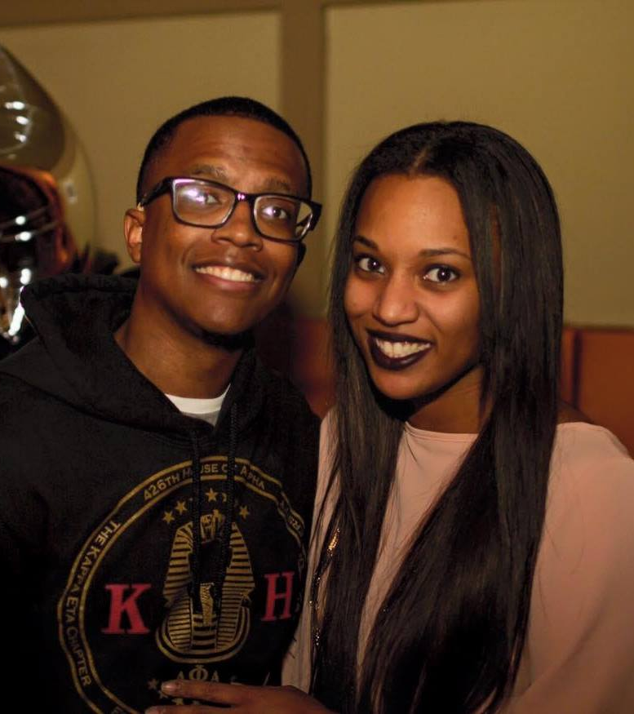
Vice President
Kevin Christopher

Slide 5
Vice President
“Assist the president.”
  These loose guidelines allow the VP the unique opportunity to tailor the job to their own skills and interests.
As vice president, you will play a role in day-to-day operations of StreetLaw, help formulate the group’s long-range plan, work out issues as they arise, and participate in executive board discussions and decision-making. That equates to a fair amount of responsibility but not necessarily a lot of time demands, which means you can take on additional responsibilities that suit your talents and availability.

Slide 6
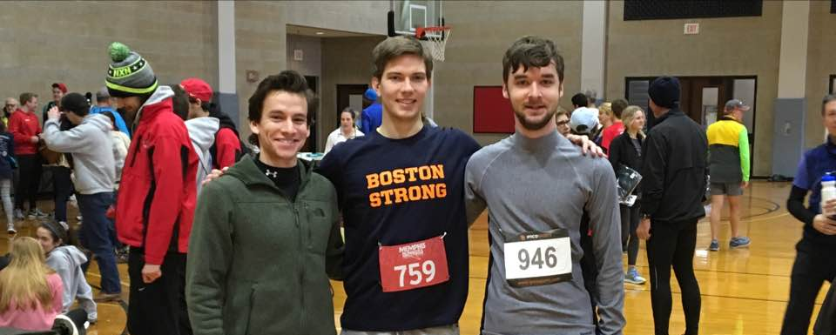
Secretary
Thomas Koelbl

Slide 7
Secretary
The secretary's role in any formal group is to be guardian of the process of meetings. They are usually the person who makes the arrangements for the meetings, and keeps formal records of the group's process and decisions: the minutes of the meeting. This may include keeping records of correspondence.

Slide 8
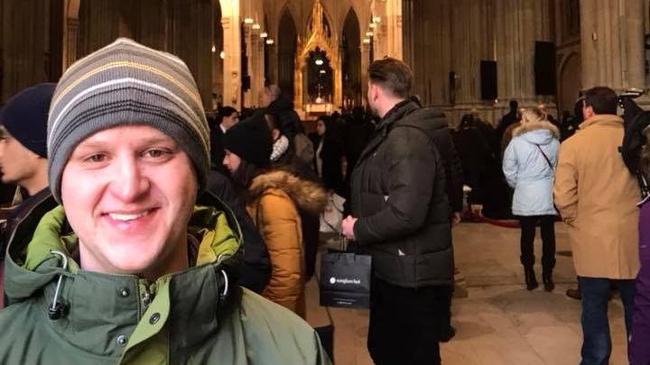
Treasurer
Scott Marston

Slide 9
Treasurer
The Treasurer has a watchdog role over all aspects of financial management, working closely with other members of the Executive Board to safeguard the organization's finances
Most importantly, he pays for lunch

Slide 10
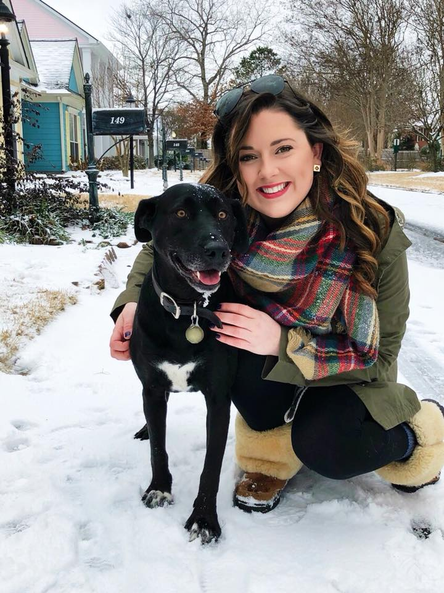
Alexandra Chunn
Public Relations Liaison

Slide 11
Public Relations Liaison
Advocate and promote the interests of StreetLaw to members, volunteers, & students
01
Volunteer Coordinator – Help with the Advocacy Camp and recruit teachers.
02
Communicator
03
On Legal Grounds Blog
Emails to Volunteers
Social Media

Slide 12
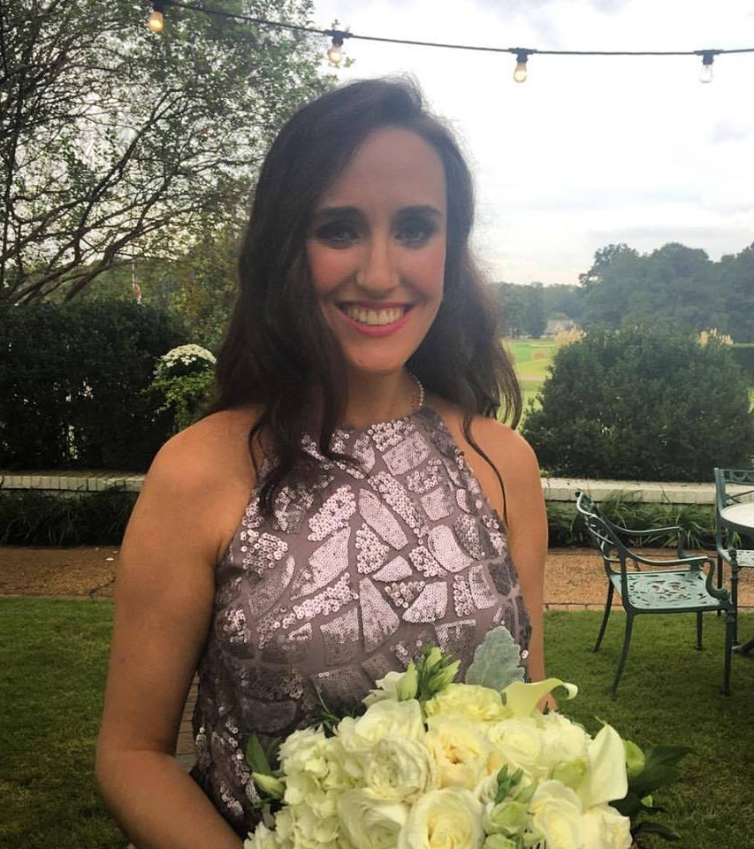
Elizabeth Stagich
Central Team Lead

Slide 13
Central High Team Lead
This position requires you to schedule classes at Central High School every month during the semester except for December and May. Your point of contact at Central High is Ms. Amy Working who teaches history and government. You will also coordinate with other Street Law board members to post signup sheets on TWEN so that law students can register to teach. This position is not time consuming and is fairly straight forward. To be successful, you must plan ahead and stay in contact with Ms. Working.

Slide 14
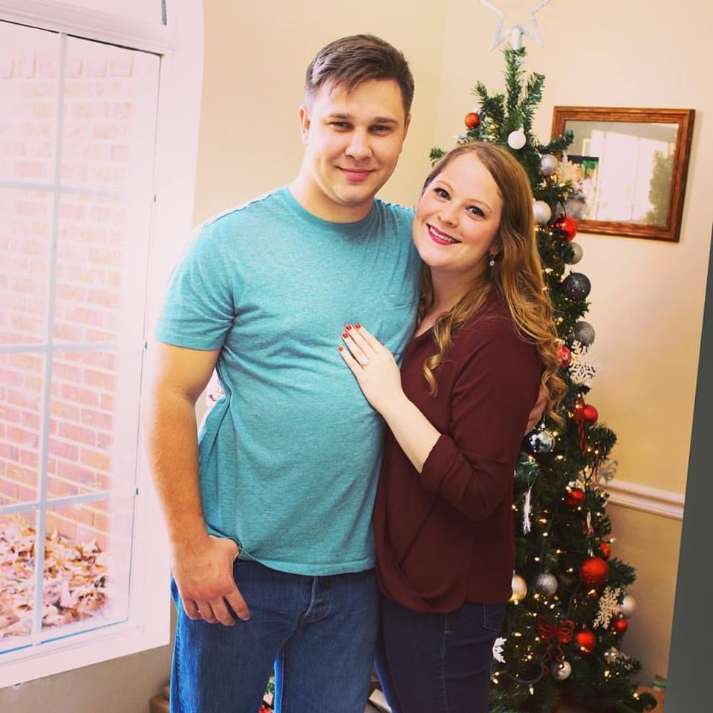
Lauren Cook
Soulsville Team Lead

Slide 15
Soulsville Team Lead
The team lead for Soulsville is responsible for setting the teaching schedule for the semester, coordinating dates and subjects with Mr. Crowder, and keeping track of the volunteers.

Slide 16
Initiatives/Programs
Advocacy Camp
Soulsville/Central High
Secure additional schools
Time slots that don’t conflict with 1L classes
Street Law 2018

Slide 17
Statement of Interest
If you are interested in applying for a position, please send us a cover letter or statement of interest.
Denote what positions you are interested in
Email them to atchunn@memphis.edu
Due Wednesday, March 28th

