Slide 1
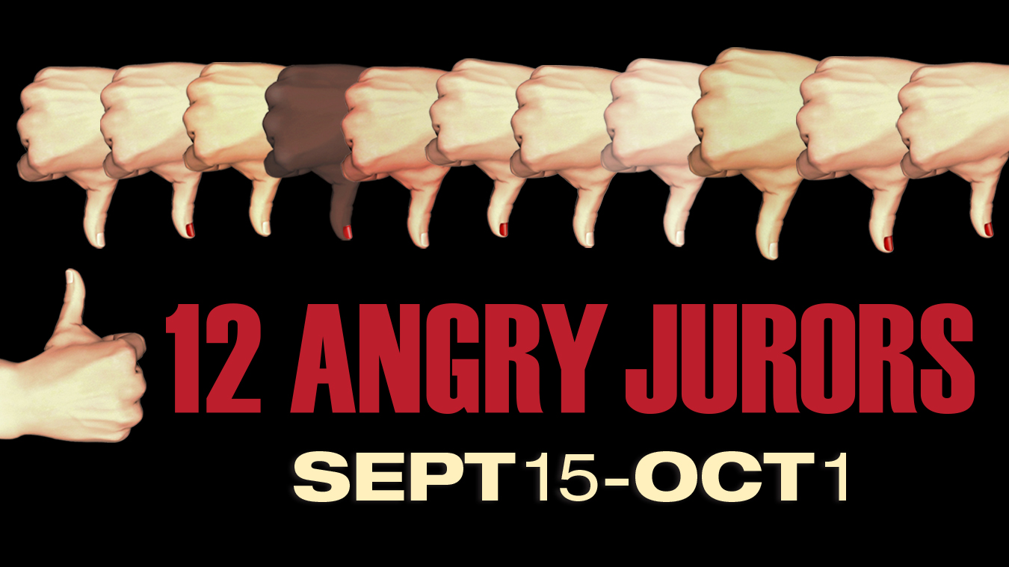
Timeless Courtroom Drama Convenes in the Next Stage
Memphis, TN - 12 Angry Jurors, a blistering character study of the American melting pot, opens at Theatre Memphis in the Next Stage September 15 and runs through October 1, 2017. Centered around the U.S. judicial system, 12 Angry Jurors, tells the story of a single juror holding the rest of the jury from a guilty verdict in a patricide trial, as she sets her sights on getting the others to look at the situation in an objective, unbiased way. What develops is a picture of America at its best… and its worst.
Originally scripted as 12 Angry Men in 1954, 12 Angry Jurors is widely acknowledged to be one of the greatest courtroom dramas of all time according to director John Rone. “The play offers a crash course in those passages of the Constitution that promise defendants a fair trial and the presumption of innocence,” Rone says, “that even today has implications in current events.” Although written before the fruition of the civil rights struggle, the subject matter remains fresh and relevant and Rone continues by stating, “Solving a crime and then presenting court room evidence for both the guilt and the innocence of the accused is inherently engrossing and often very exciting. However, the deliberations of a jury to decide the fate of the accused is truly the most thrilling and compelling drama of all.”
Theatre Memphis Executive Producer Debbie Litch likes the relevance that 12 Angry Jurorsbrings to the table. “It asks timeless questions that touch something deep within us … and if that isn’t contemporary drama I don’t know what is,” she relates. And she adds, “Theatre should entertain but this is a great case where it can educate as well. This story is relatable today in every way.”
###
TITLE: 12 Angry Jurors
WRITTEN BY: Reginald Rose, Stage version by Sherman L. Sergel
DIRECTOR: John Rone
VENUE AND ADDRESS: Theatre Memphis in the Next Stage, 630 Perkins Ext, Memphis, TN, 38117
RUN DATES: September 15 - October 1, 2017 [September 29, 2017 Law Student Night]
TIMES OF SHOWS: Thursdays @ 7:30pm, Fridays and Saturdays @ 8pm with matinees @ 2pm on Sundays
TICKETS: $25 adults, $15 student; $20 Military and 62 and older
BOX OFFICE: 901.682.8323
WEB: www.theatrememphis.org

